Slide 1

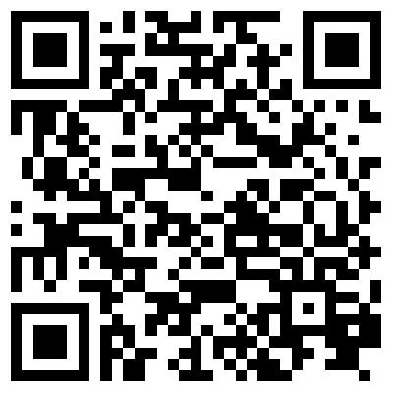

GSS Open Access Award
Application Deadline Extended: October 13th, 2017
Apply Here: http://sfugradsociety.ca/services/gss-open-access-award-gssoaa/
LIBRARY

Slide 2
GSS Open Access Award
Application Deadline Extended: October 13th, 2017
LIBRARY

